Slide 1

Guide Word Fun!
By Teachers Unleashed

Slide 2
Guide Words
Guide Words are the words at the top of each dictionary page that help you to know what words can be found on that page.
They are incredibly helpful when you are looking for a certain word in the dictionary.

Slide 3
Guide Words
The first word on the dictionary page and the last word will be the guide words for the page.
The rest of the words on the dictionary page will be between those two.

Slide 4
Guide Words
The first word on the page is leg.
The last word on the page is lemonade.
Here’s an example.
leg-lemonade
leg: (lĕg) n. A limb used for standing and moving.
legume: (lĕg•ōōm) n. A plant that grows seeds in pods.
lei: (lā) n. A garland of flowers worn around the neck.
lemming: (lĕm•ĭng) n. A small, thick rodent that is known to migrate.
lemon: (lĕ•mən) n. The fruit of a lemon tree. The lemon is sour and contains citric acid.
lemonade: (lĕ•mə•nād) n. A drink made from water, lemon juice, and sugar.

Slide 5
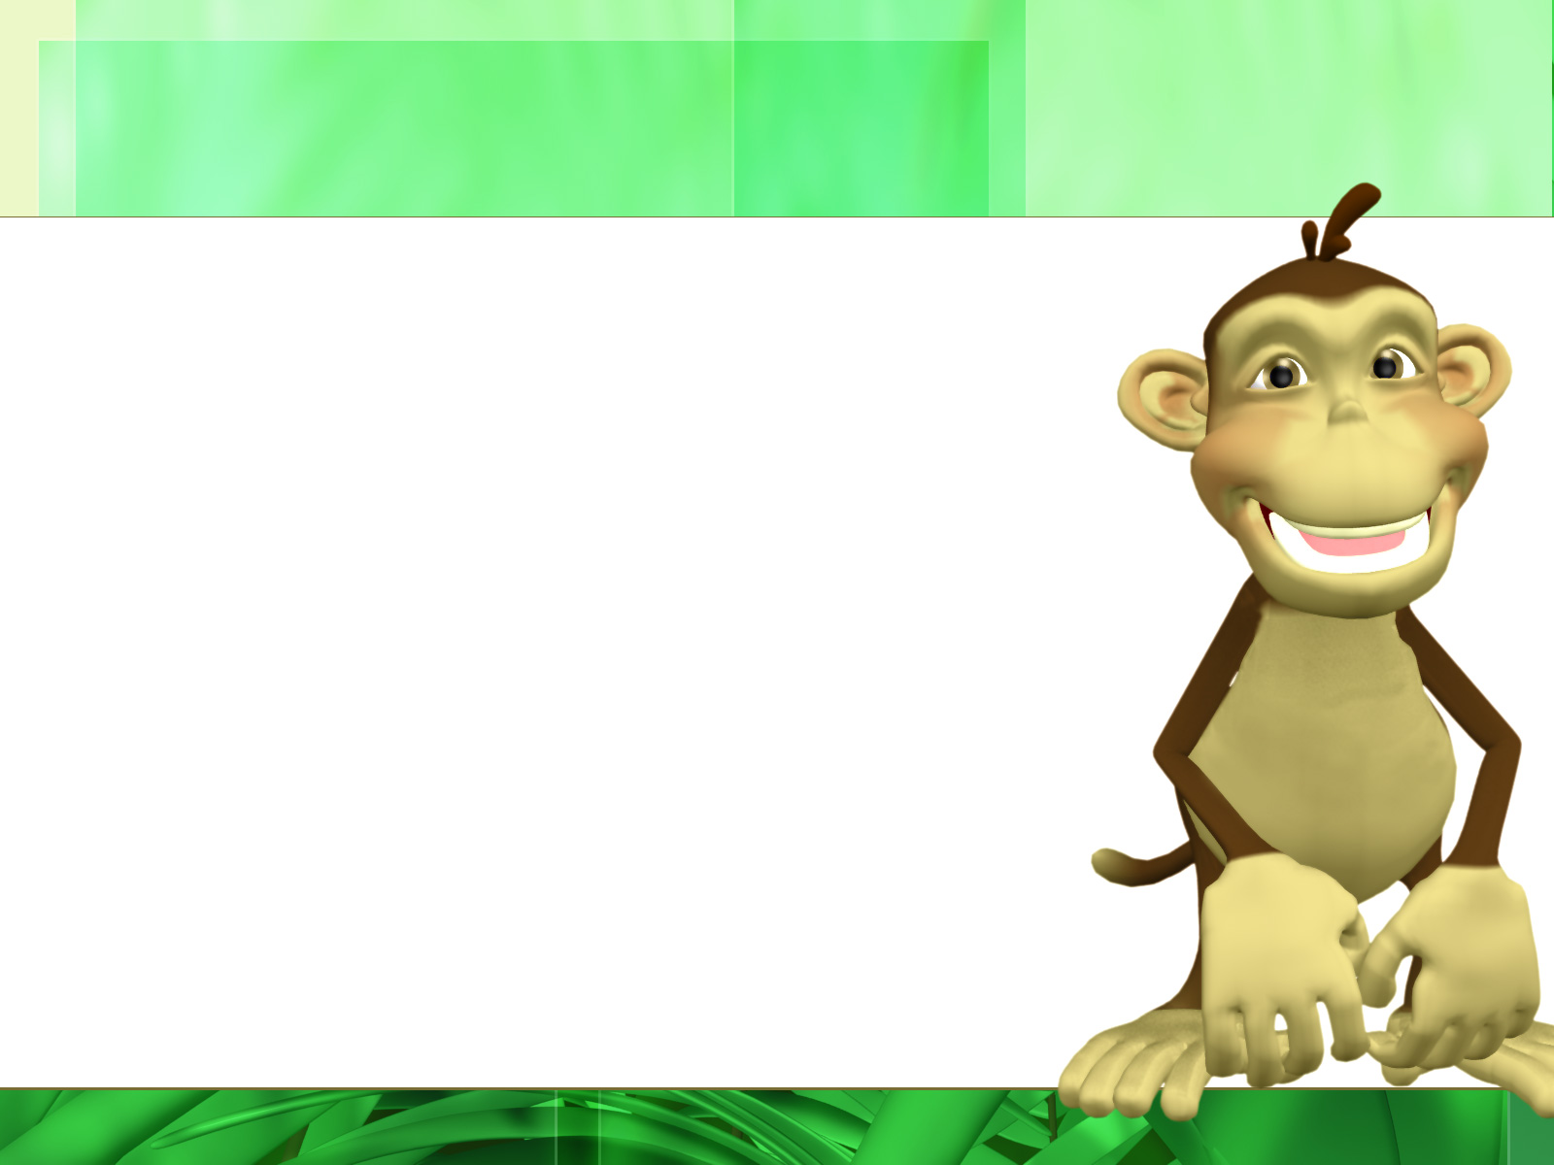

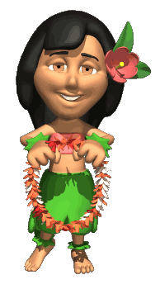
Take the word lei for example.
leg-lemonade
leg: (lĕg) n. A limb used for standing and moving.
legume: (lĕg•ōōm) n. A plant that grows seeds in pods.
lei: (lā) n. A garland of flowers worn around the neck.
lemming: (lĕm•ĭng) n. A small, thick rodent that is
known to migrate.
lemon: (lĕ•mən) n. The fruit of a lemon tree. The lemon
is sour and contains citric acid.
lemonade: (lĕ•mə•nād) n. A drink made from water,
lemon juice, and sugar.
Lei is on this dictionary page because it falls between the guide words leg and lemonade in alphabetical order.

Slide 6
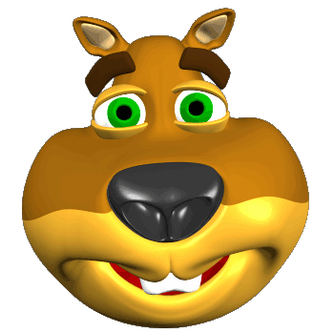
Will the word lemming be found on this page?
leg-lemonade
Yes! Lemming will be on this page. It comes after leg and before lemonade.
leg-lemonade
leg: (lĕg) n. A limb used for standing and moving.
legume: (lĕg•ōōm) n. A plant that grows seeds in pods.
lei: (lā) n. A garland of flowers worn around the neck.
lemming: (lĕm•ĭng) n. A small, thick rodent that is
known to migrate.
lemon: (lĕ•mən) n. The fruit of a lemon tree. The lemon
is sour and contains citric acid.
lemonade: (lĕ•mə•nād) n. A drink made from water,
lemon juice, and sugar.

Slide 7
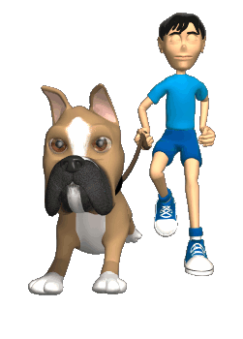
Will the word leash be found on this page?
leg-lemonade
leg: (lĕg) n. A limb used for standing and moving.
legume: (lĕg•ōōm) n. A plant that grows seeds in pods.
lei: (lā) n. A garland of flowers worn around the neck.
lemming: (lĕm•ĭng) n. A small, thick rodent that is known to migrate.
lemon: (lĕ•mən) n. The fruit of a lemon tree. The lemon is sour and contains citric acid.
lemonade: (lĕ•mə•nād) n. A drink made from water, lemon juice, and sugar.
No! Leash will not be on this page. It comes before both leg and lemonade.

Slide 8
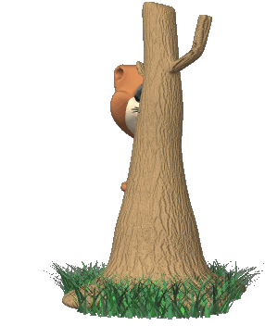
Will the word lemur be found on this page?
leg-lemonade
leg: (lĕg) n. A limb used for standing and moving.
legume: (lĕg•ōōm) n. A plant that grows seeds in pods.
lei: (lā) n. A garland of flowers worn around the neck.
lemming: (lĕm•ĭng) n. A small, thick rodent that is known to migrate.
lemon: (lĕ•mən) n. The fruit of a lemon tree. The lemon is sour and contains citric acid.
lemonade: (lĕ•mə•nād) n. A drink made from water, lemon juice, and sugar.
No! Lemur will not be on this page. It comes after both leg and lemonade.

Slide 9
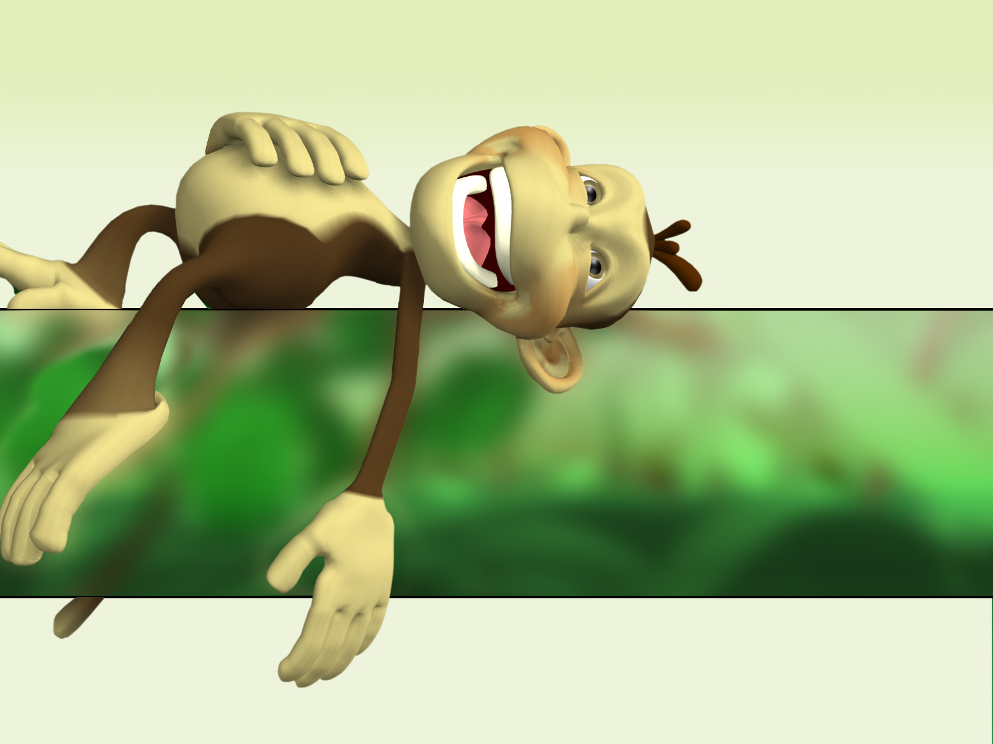
That’s really all there is to it. You will just need to pull out your alphabetizing skills!
Pretty easy, right?

Slide 10
Which of these words would be found on the dictionary page with the following guide words?
corn - toaster
distant
underneath
people
world
golf

Slide 11
Which of these words would be found on the dictionary page with the following guide words?
apple - change
attic
doormat
varmint
camel
mash

Slide 12
Which of these words would be found on the dictionary page with the following guide words?
farm - multitude
danger
goat
charity
llama
remedy

Slide 13
Which of these words would be found on the dictionary page with the following guide words?
happy - heart
hairy
horn
whole
hear
harness

Slide 14
Which of these words would be found on the dictionary page with the following guide words?
people - possible
party
pocket
pleasant
puppy
personal

Slide 15
Which of these words would be found on the dictionary page with the following guide words?
believe - bobble
benefit
bean
bibliography
baste
bunt

Slide 16
Which of these words would be found on the dictionary page with the following guide words?
address - attractive
awkward
addition
eat
arrive
arena

Slide 17
Which of these words would be found on the dictionary page with the following guide words?
satisfy – sea shanty
secret
school-bus
shrimp
scale
tone

Slide 18
Which of these words would be found on the dictionary page with the following guide words?
teal - template
turbulence
terraform
teaspoon
theory
teen

Slide 19
You’ve done a tremendous job so far! Ready to put your effort into some test questions?
Carefully read all of the answers. I can be tricky!

Slide 20
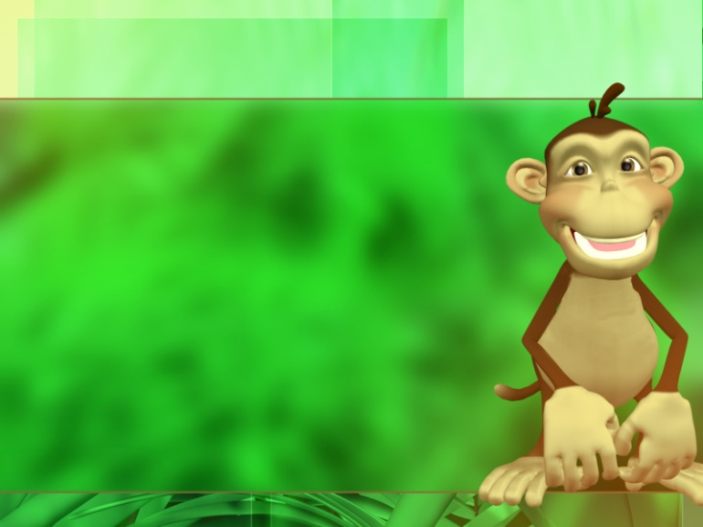
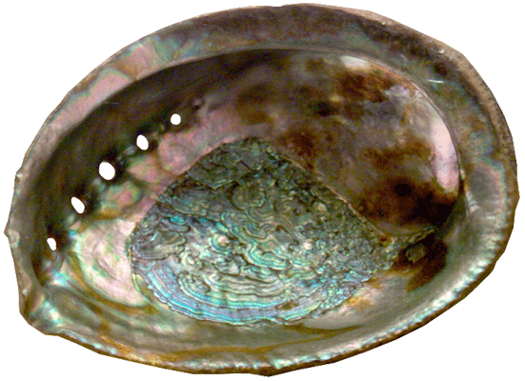
Which guide words would you find on a dictionary page with the word abalone?
Remember, the word above will come after the first word and before the second word.
a. aging - accent
b. antique - break
c. above - argue
d. abacus - azure

Slide 21
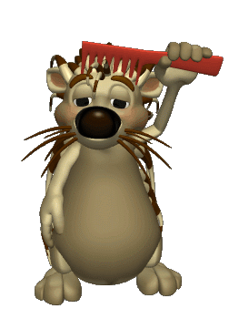
Which guide words would you find on a dictionary page with the word comb?
a. cabin - cleat
b. chop - crumb
c. cover - crows
d. cargo - cinder

Slide 22
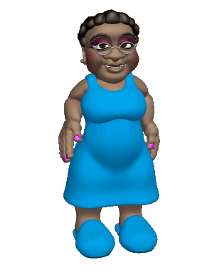
Which guide words would you find on a dictionary page with the word friendly?
a. clear - meaning
b. friendship - gigantic
c. daily - durable
d. succeed - windmill

Slide 23
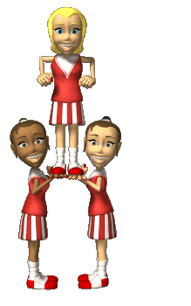
Which guide words would you find on a dictionary page with the word formation?
a. force - frost
b. festival - fetch
c. fable - fame
d. fresh - future

Slide 24
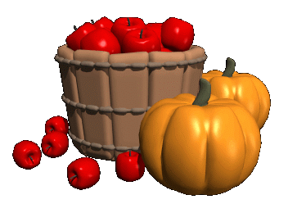
Which guide words would you find on a dictionary page with the word harvest?
a. heart - height
b. hand - handful
c. hanky - haze
d. heavy - human

Slide 25
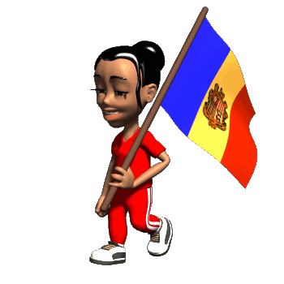
Which guide words would you find on a dictionary page with the word national?
a. neuron - notice
b. nightly - nodding
c. nation - necklace
d. nab - narrate

Slide 26
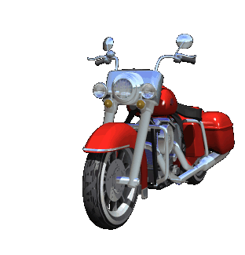
Which guide words would you find on a dictionary page with the word light?
a. laborer - lengthy
b. lower - lug
c. laundry - lichen
d. liger - lower

Slide 27
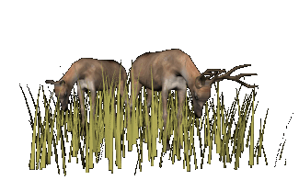
Which guide words would you find on a dictionary page with the word meadow?
a. marshmallow - meadow
b. meadows - mermaid
c. moustache - muddy
d. mall - manage

Slide 28
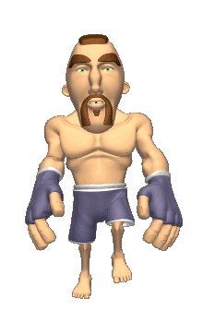
Which guide words would you find on a dictionary page with the word wrestler?
a. weasel - wheeze
b. wasp - warden
c. waitress - waterlog
d. word - write

Slide 29
Final Task
Using your dictionary, look up each word on this list and write down the guide words from the page you found it on. If you cannot find the word in the dictionary, write NF (not found).
primate vocal
ape fruit
wise swing
tail climb
exotic baboon
curious gibbon
When you’re finished, try to decide what all of these words describe. Write it down.
If you guessed that these words have to do with monkeys, you are RIGHT!

Slide 30
Additional Task
Using your dictionary, look up each word on this list and write down the guide words from the page you found it on. If you cannot find the word in the dictionary, write NF (not found).
rain croak
rainforest vine
tangle fruit
bird dense
monsoon decompose
understory tropical
When you’re finished, try to decide what all of these words describe. Write it down.
If you guessed that these words have to do with the jungle, you are RIGHT!

Slide 31
Thanks for choosing
TEACHERS
UNLEASHED
to help your students learn dictionary skills!
To see more of our great products, click our store link below:
TEACHERS UNLEASHED STOREFRONT

